Slide 1

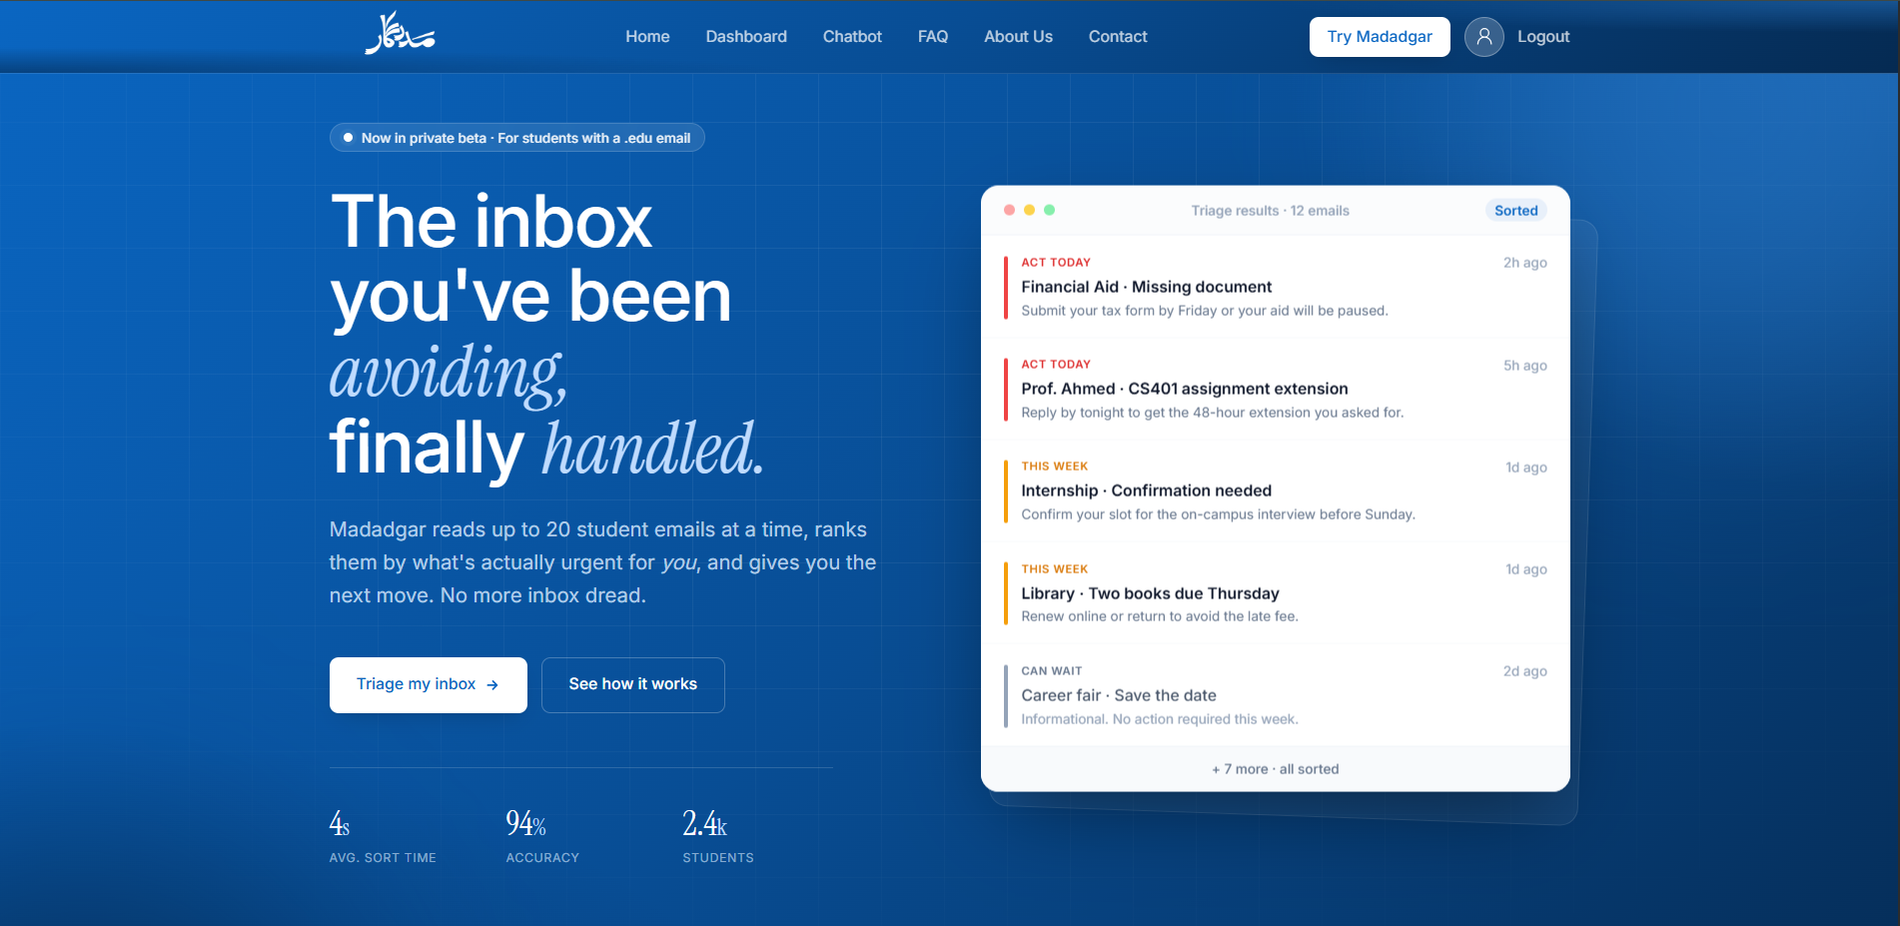
AI-powered student assistant
Smarter access to scholarships, internships, and deadlines
Presenter: Anamta Gohar

Slide 2
Problem
Students miss important opportunities
Emails are crowded and hard to track
Manual searching takes too much time

Slide 3
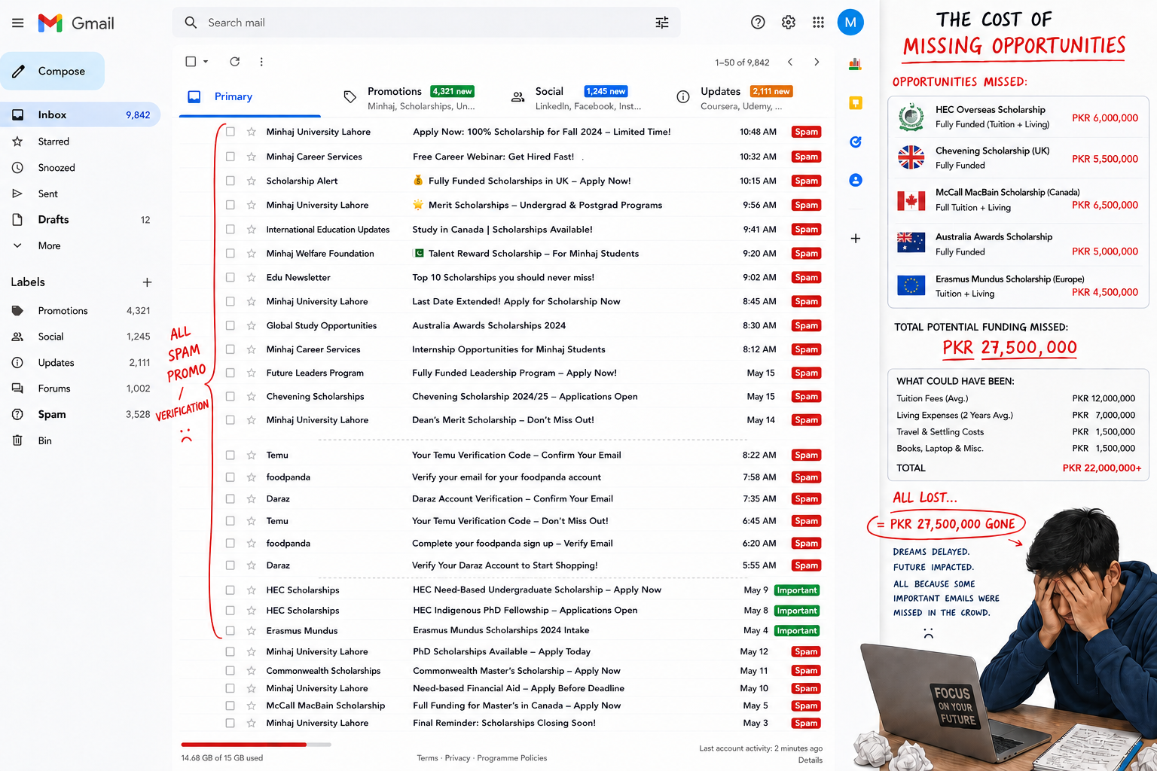
Problem
Students miss important opportunities
Emails are crowded and hard to track
Manual searching takes too much time

Slide 4
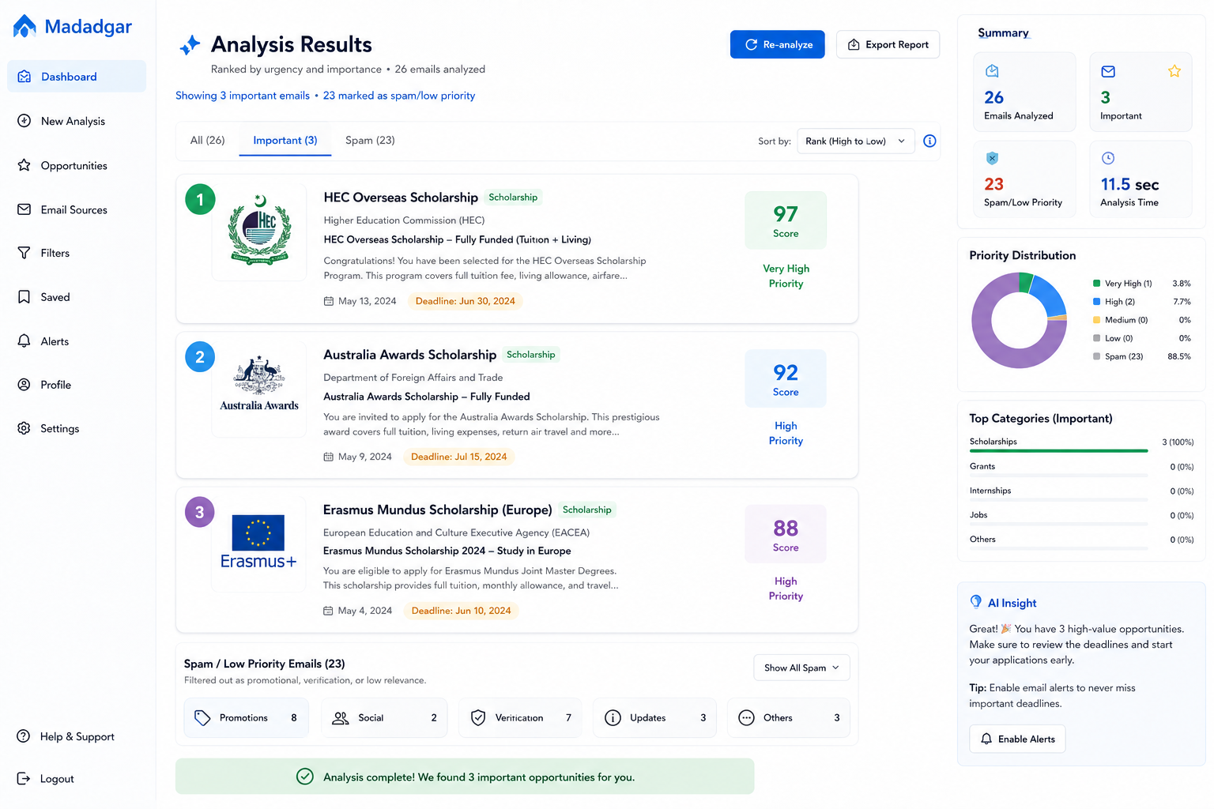
What Madadgar Does?
Reads student emails
Detects relevant opportunities
Prioritizes what matters most
Student Specialized
Simple flow: Email → AI → Ranked list

Slide 5
How It Works?
Uses LLMs + RAG to extract key information
Ranks opportunities by profile, preferences, urgency, and eligibility
Filters emails using ML

Slide 6
Core Features
1
2
3
4
5
6
Scholarships
Internships
Deadlines
Career guidance
Personalized next steps
Persnalized Chabot

Slide 7
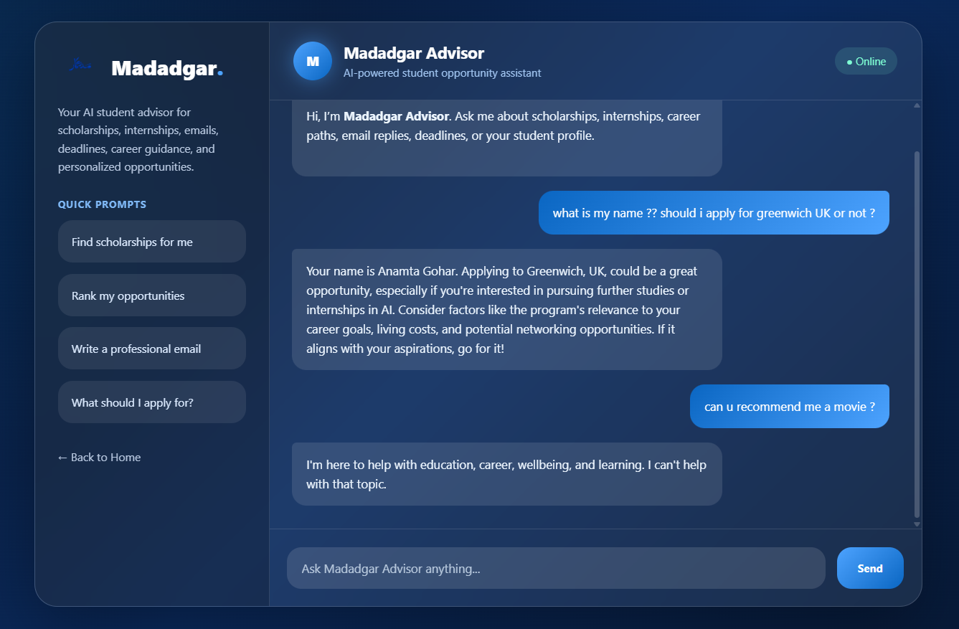
Smart Chatbot
Student-profile specific chatbot
Built with LLM + RAG
Helps with studies, careers, and scholarship emails
Guardrails ensure safe responses

Slide 8
Tech Stack
HTML / CSS / JS / Python
Chatbot LLM + RAG
Personalized
Guardrails

Slide 9
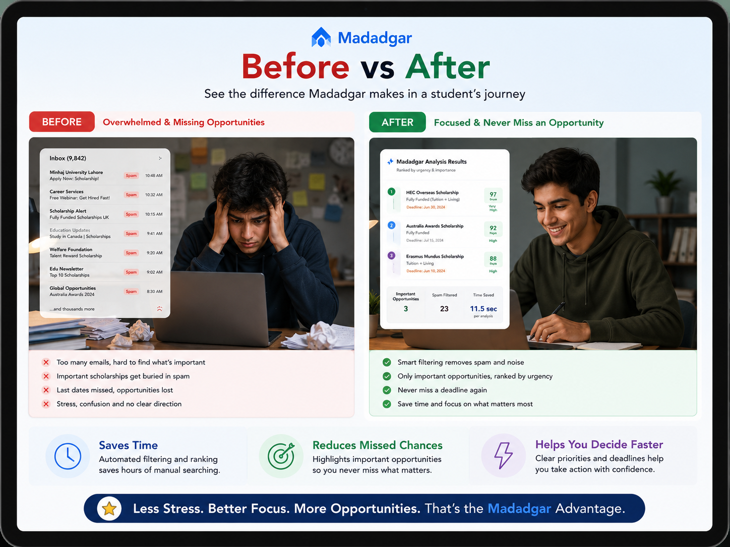

Why It Matters?
Saves time
Reduces missed chances
Helps students make faster decisions

Slide 10
Empowering Students with AI
Madadgar helps students find the right opportunities faster
One smart assistant for better decisions

Slide 11
THANK YOU
Contact Us for Inverstment: 03284357188

